Slide 1

ONLINE HOSTING
How to deploy and host a Web Application and a Database
Feat AWS, Azure and Heroku

Slide 2

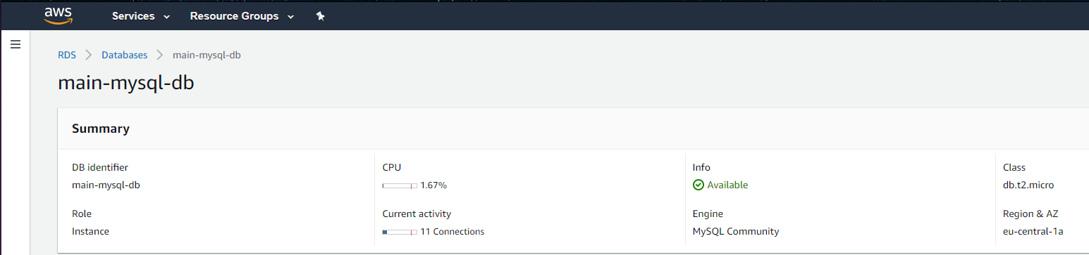
How to host a Database
We have decided to host a mySQL database on Amazon Web Service (AWS) using its Relational Database Service (RDS)
The hosting is free for one instance as part of AWS Free Tier

Slide 3
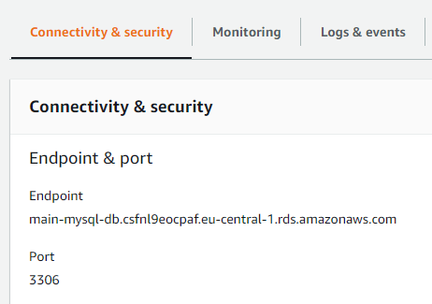
How to access a hosted database
AWS provides us with an endpoint (a link) we can use to connect.

Slide 4
How to access a hosted database
That endpoint can then be used within java application.properties
We have also obtained a domain and made it redirect to said endpoint

Slide 5
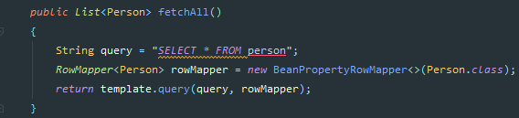
How to send queries using JDBC

Slide 6
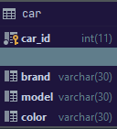
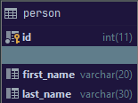
Database Structure

Slide 7
How to deploy a Web App on Azure
We have decided to deploy to Azure by using an official Azure plugin for Maven. It allows easy deployment directly from IntelliJ
A guide can be found here

Slide 8
How to deploy a Web App on Heroku
Heroku is a free web app hosting service (but with Github Education you can get a paid tier) which allows hosting. It requires the project to use Git and some minor modifications to the code

Slide 9
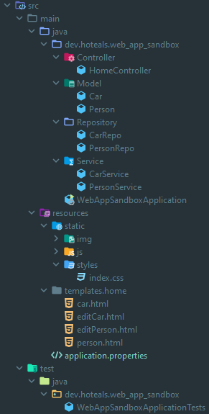
Code Structure
The Web App is made using Java Spring It consists of a Model, Repository, Service and Controller layer which majority of the backend code, including the SQL queries All of the frontend code is kept in resources

Slide 10
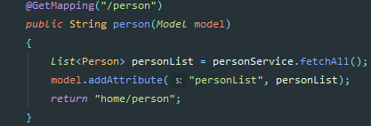
Code Structure
Passing of data between the frontend and backend is handled by the controller

Slide 11
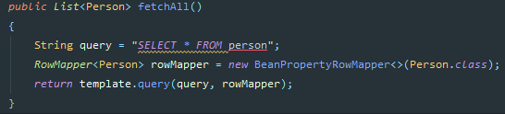
Code Structure
The SQL queries are done in the repository and passed to the Controller via the Service Layer. The data provided as a Model object, which represent database tables

Slide 12
User Interface
The user interface is the web page itself In our project, it displays a list of Persons and Cars and allows adding, edition and deletion of said objects
The website is hosted on Azure and Heroku

